Slide 1
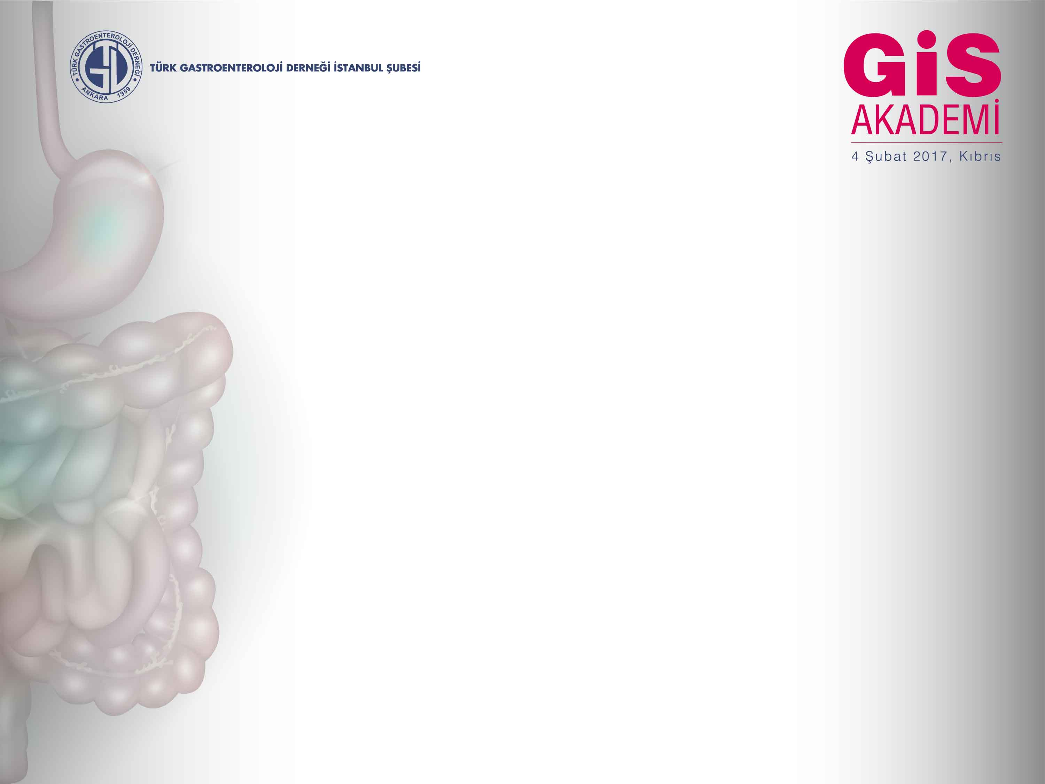
PPI uzun süre kullanımı:
yanlışlar ve doğrular
Prof. Dr. Filiz AKYÜZ
İstanbul Tıp Fakültesi
Gastroenteroloji BD

Slide 2
Uzun süreli [> 3 ay – (2-12 ay)]*
PPI kullanımı gerektiren nedenler
Gastroözofageal reflü hastalığı
Bazı peptik ülserli olgularda
  NSAİİ ± ASA kullanımı
  Hipersekresyon durumları ile nadir nedenler
  Vanderhoff BT, Tahboub RM. Am Fam Physician 2002;66:273-280
  Goudie BM et al. Aliment Pharmacol Ther 1996;10:147-150
  Raghunath AS, Hungin APS. Gut 2004;53 (Suppl 111):A24
  Majumdar SR et al. Am J Gastroenterol 2003;98:2409-2414

Slide 3
PPI yan etkileri
Baş ağrısı
Bulantı
Karın ağrısı
Raş
Uykusuzluk
Yorgunluk
Kabızlık
İshal (öz. LAN)
Kaşıntı
Miyopati
………..
Freston JW et al. Aliment Pharmacol Ther 29, 1249–1260

Slide 4
Çekincelerin dayanakları
Hipoasidite;
  Doğal bağışıklıkta bariyer ortadan kalkar
  “Gastrik bakteriyel kolonizasyon”
  “İnce barsak kontaminasyon sendromu”
  Antral G hücrelerinde hiperplazi
  “Hipergastrinemi”
  GİS epiteli üzerinde trofik etkili
  Enterokromaffin benzeri hücrelere trofik
Sitokrom p450 enzim sistemi ile etkileşim

Slide 5
POTANSİYEL RİSKLER
Notes:
With the long-term use of any medication, drug safety becomes an important issue. The three main concerns regarding the long-term safety of proton pump inhibitors (PPIs) include the effects of prolonged hypochlorhydria and hypergastrinemia, and the possible association of PPIs with gastric atrophy.
C. difficile is an anaerobic organism that sporulates; acid-resistant spores are presumed to be the major vector of disease transmission. The role of potent acid suppression and the pathophysiologic mechanisms involved in increasing the risk of C. difficile by PPI use are unclear.

Slide 6
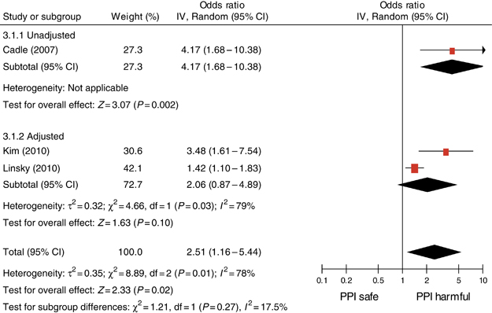
Enterik infeksiyonlar (C.difficile 2 kat artar)
Kwok CS, et al. AJG 2012
Notes:
Despite the evidence suggesting an association between PPI and C. difficile infection, the pathogenesis is still poorly understood. The hypothesis that by reducing gastric acidity, PPI would prevent gastric acid from killing C. difficile spores has recently been disproved in a study that demonstrated survival of C. difficile spores in an acidic environment.13 In the absence of a clear relationship between gastric acid suppression and C. Difficile infection, other mechanisms have been proposed to explain the association between C. difficile infection and PPI. Of interest, H+/K+ ATPases, the target of PPI, have been identified on rabbit colon, but the precise mechanisms through which PPI may increase susceptibility to C. difficile infection remain speculative.

Slide 7
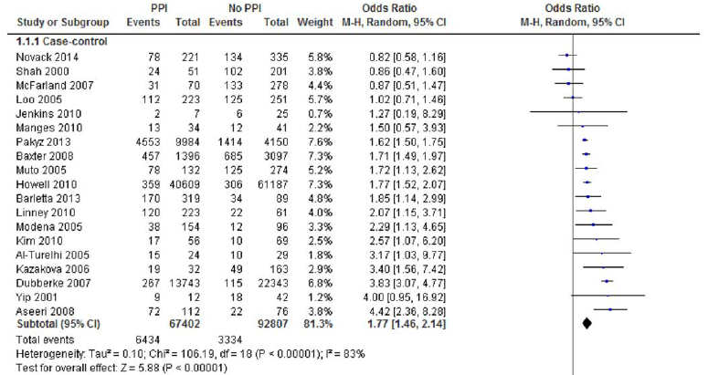
PPI kullanımı ile CD riski artar
oR 1.8
Vanessa Arriola,, et al.Infect Control Hosp Epidemiol 2016;1–10

Slide 8
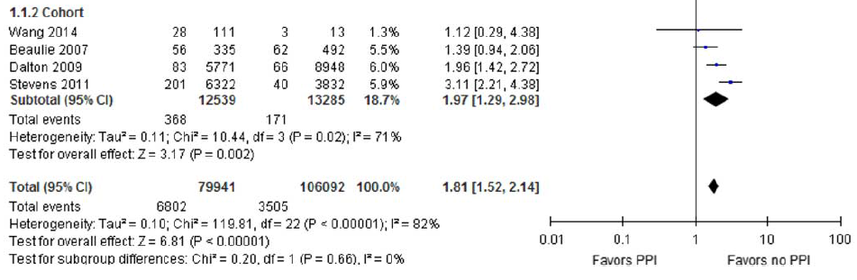

PPI kullanımı ile CD riski artar oR 1.8
Vanessa Arriola,, et al.Infect Control Hosp Epidemiol 2016;1–10

Slide 9
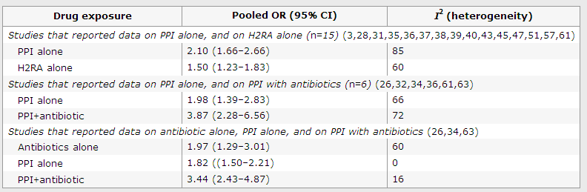
Antibiyotik ile kombine ise risk daha fazla
Kwok CS, et al. AJG 2012

Slide 10
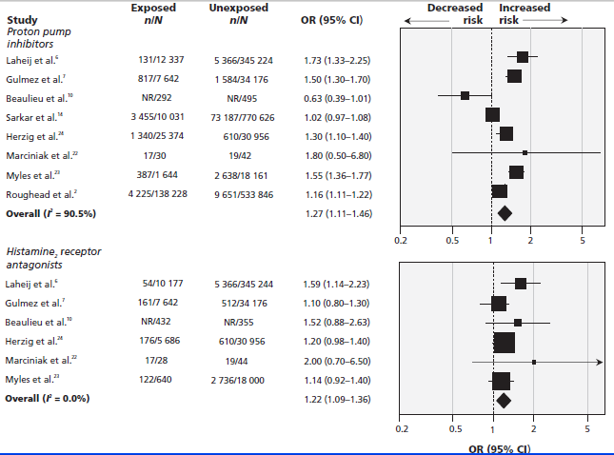
Pnömoni riski artar
Eom CS, et al CMAJ 2011; 183:310.
Notes:
PPI use is associated with increased intragastric aerobic bacteria, and with the production of acetaldehyde from alcohol. The increased bacterial colonization of the stomach observed with PPI users may be associated with pulmonary micro-aspiration and lung colonization.

Slide 11
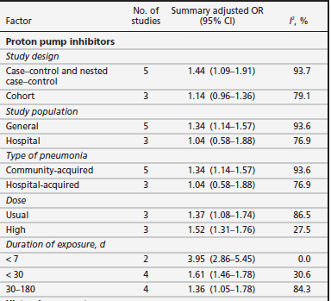
Kısa dönemde hastane yatışında daha fazla
Eom CS, et al CMAJ 2011; 183:310.
Notes:
Kısa dönemde hastane yatışında daha fazla
Gastric acid acts as a barrier that keeps bacteria
from colonizing the upper gastrointestinal tract and can
also influence the composition of intestinal normal flora.
Therefore, PPI-induced hypochlorhydria could lead to
respiratory infections, through reflux or enteric infections,
by allowing transmission of ingested viable pathogens.
Furthermore, PPIs can interfere with neutrophil
function, which would further increase the risk of bacterial
infection, although this in vitro effect is unlikely to
be physiologically relevant to patients on oral PPI therapy.
100

Slide 12
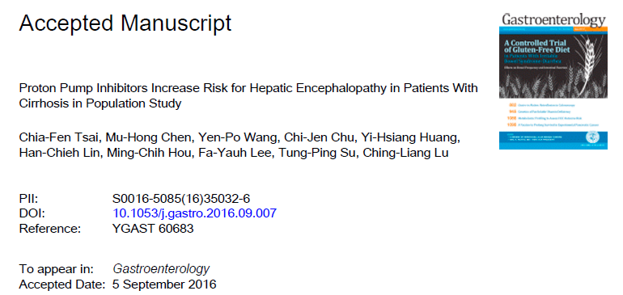
Hepatik ensefalopati

Slide 13
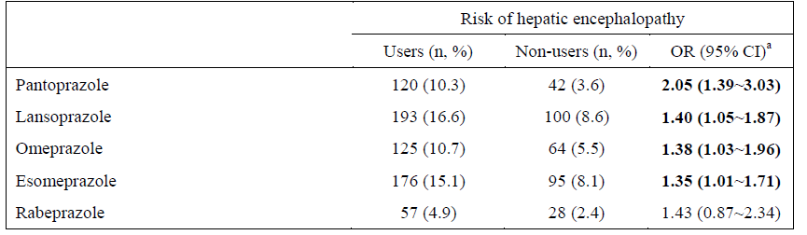
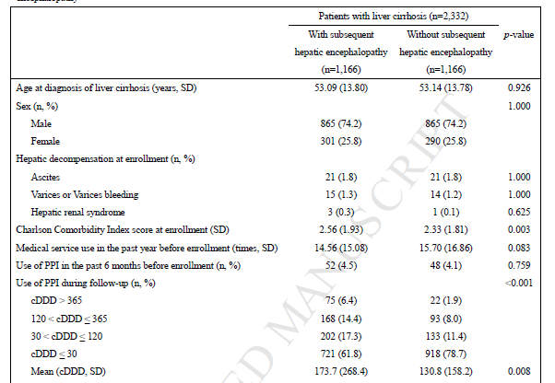
Doza bağımlı risk artışı var
Chia-Fen Tsai, et al. Gastroenterology 2016

Slide 14
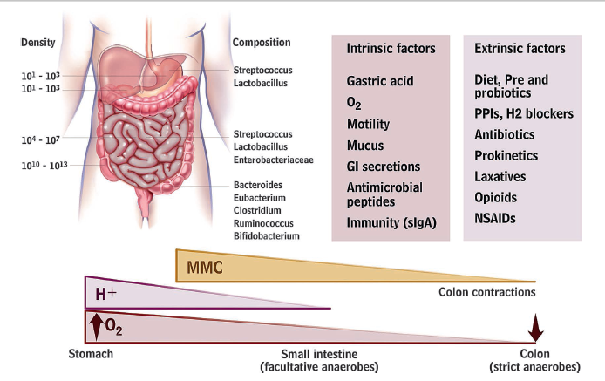
Mikrobiota değişikliği……
Simren M, et al. Gut 2013;62:159–176.

Slide 15
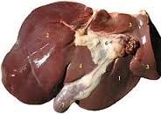
Bakteriyel Translokasyon
RES, karaciğer yetmezliği
Tsao G, et al. Best Prac & Res Clin Gastroenrol 2004
LPS
Sitokin
Bakteriyel DNA
Bakteri
Nörotoksin
Amonyak
Benzodiazepin
SBP
Hiperdinamik sirkulatuar sendrom
HE
Varis kanaması
Böbrek yetmezliği
Notes:
Mechanisms of bacterial translocation in cirrhosis and its relationship to the pathogenesis of spontaneous bacterial peritonitis (SBP), the hyperdynamic circulatory state (HCS) and hepatic encephalopathy (HE). Cirrhosis leads to bacterial translocation via different mechanisms: (1) a delayed intestinal transit time, and possibly malnutrition, lead to intestinal bacterial overgrowth, mainly of enteric Gram-negative bacteria; (2) intestinal mucosal oxidative stress augmented by translocation of bacteria, nitric oxide and cytokines such as necrosis factor (TNF) lead to increases in intestinal permeability; and perhaps most importantly, (3) an impairment in intestinal immunity leading to an impaired phagocytic activity. Gut-associated lymphatic tissue (GALT) produces cytokines in response to translocation rendering the gut a cytokine-releasing organ. In cirrhosis, a failure of the hepatic reticuloendothelial system (RES) due to impaired RES phagocytic activity and portosystemic shunting, allow bacteria, bacterial products, endotoxins (LPS), cytokines and neurotoxic nitrogenous compounds such as ammonia, into the systemic circulation. Bacteria, bacterial products (endotoxins) and cytokines induce synthesis of the vasodilator nitric oxide (NO), leading to splanchnic and systemic vasodilatation and thus to the HCS that, in turn, worsens complications of cirrhosis such as variceal haemorrhage. In the presence of ascites and severe liver dysfunction (which correlates with immune
dysfunction) circulating bacteria seed ascites, producing SBP. An overt bacterial infection such as SBP leads to
further haemodynamic alterations that may result in renal failure. Lastly, gut-derived neurotoxins such as
ammonia and benzodiazepines contribute to the development of HE.

Slide 16
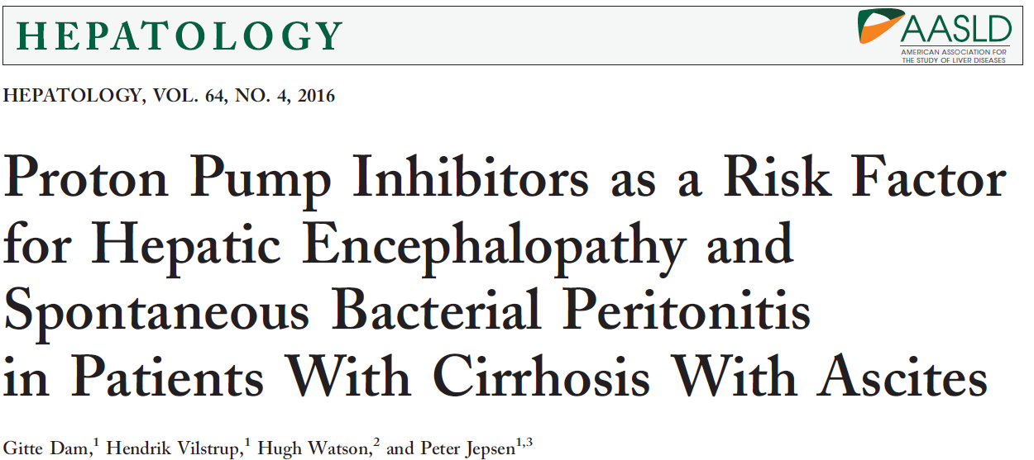
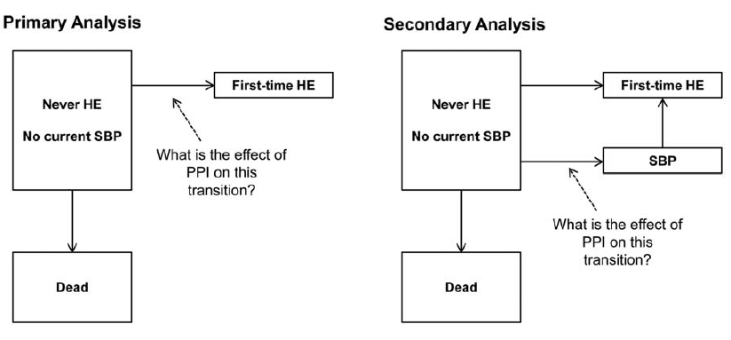

Slide 17
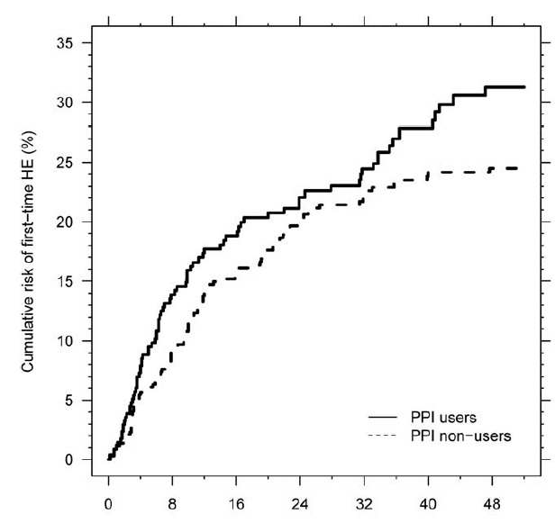
HE için HR 5 95% CI, 1.21-1.91
Takipte %86 hastada SBP gelişti.
SBP için 1.72 (95% CI, 1.10-2.69).
Dam G, et al. Hepatology 2016

Slide 18
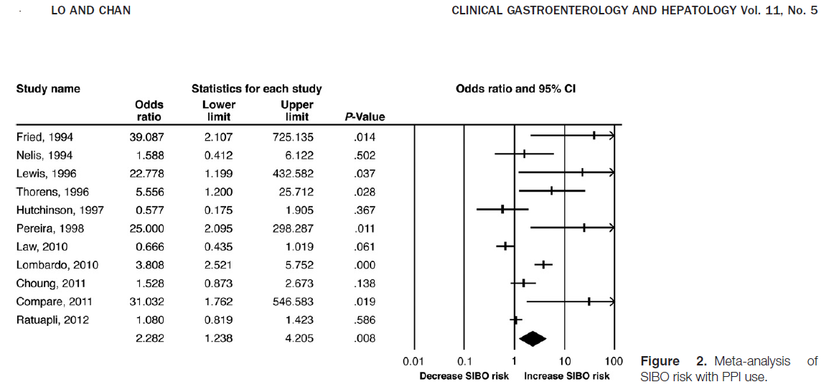
SIBO riski artmıştır
2013

Slide 19
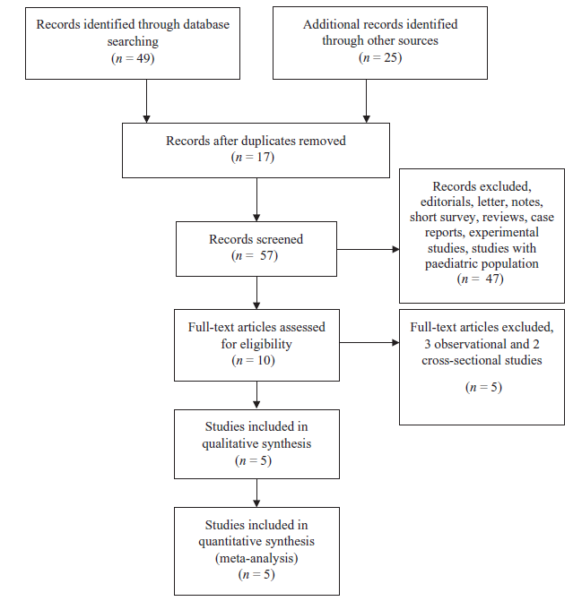
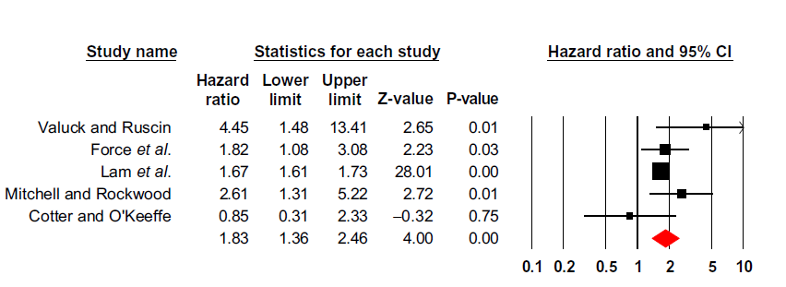
Ppı kullanımı B 12 eksikliğine neden olur hr 1.83,95 % cı 1.36-2.46
Jung SB et al. Intern Med J. 2015

Slide 20
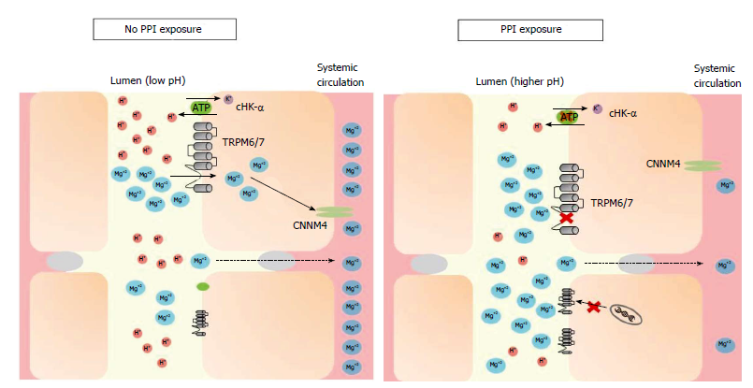
Hipomagnezemi
HE için risk faktörü oluşturuyor
William J, et al.World J Nephrol 2016
Notes:
Under conditions of magnesium deficiency, proton-pump inhibitors may inhibit magnesium absorption by increasing the pH of the intestinal lumen, through both gastric and non-gastric antagonism of the H+-K+ ATPase pump (“proton pump”). TRPM6/7 affinity for magnesium decreases in a higher
pH environment. While this may trigger mRNA transcription of TRPM6 channels in most individuals, hypomagnesemia may develop when this compensation is
incomplete or the individual has additional risk factors. TRPM: Transient receptor potential melastatin; cHK-α: Colonic hydrogen-potassium ATPase; CNNM4: Cyclin
M4; PPI: Proton-pump inhibitor. World J Nephrol 2016

Slide 21
He riskinin artışı
SIBO
B12 eksikliği
Hipomagnezemi

Slide 22
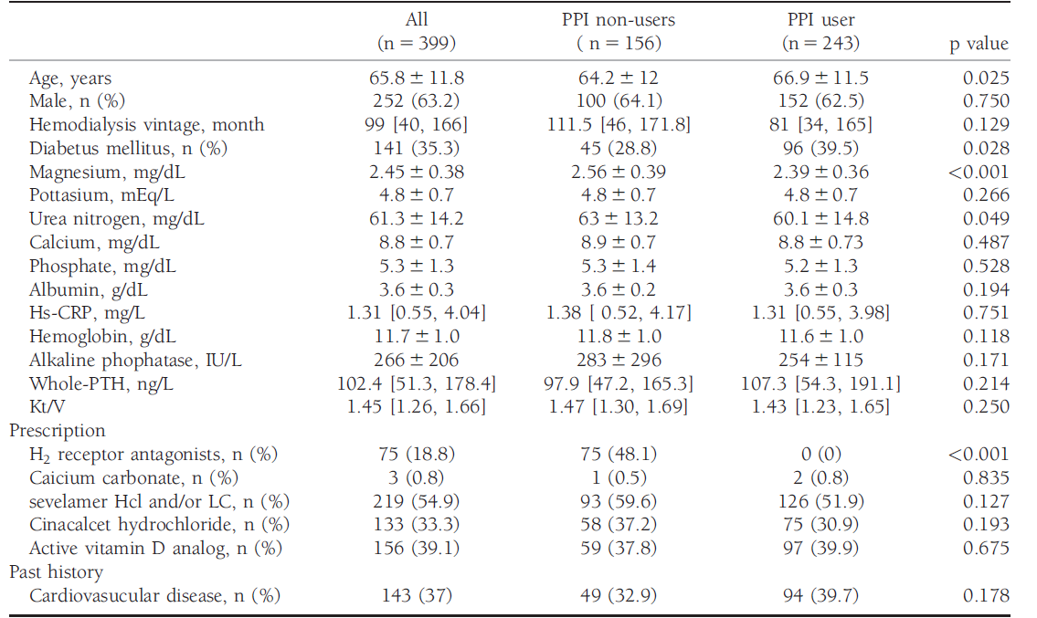
Hemodiyaliz hastalarında da hipomagnezemiye neden olur
Ago R. et al.Hemodialysis International 2016; 20:580–588

Slide 23
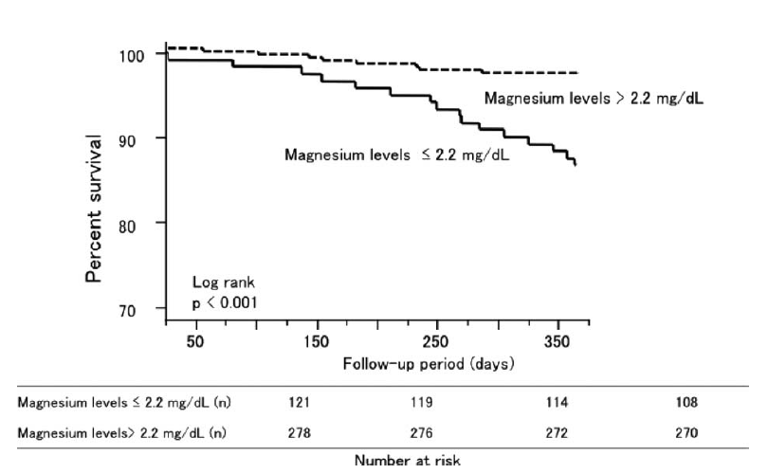
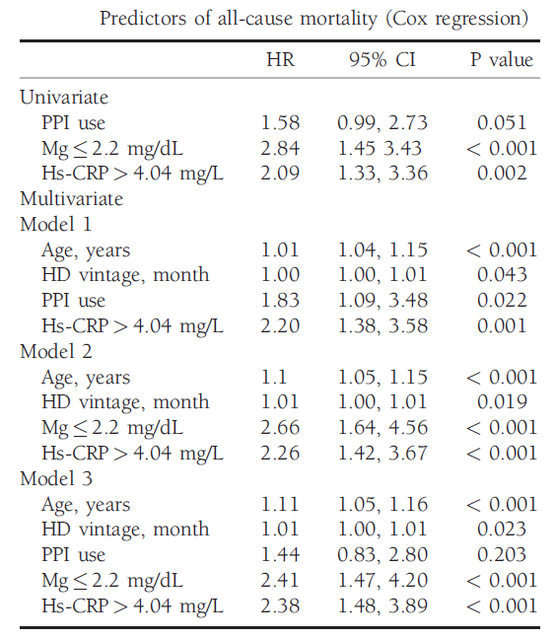
PPI kullanlarda Mg düzeyi düşüktür
Mg düşüklüğü inflamatuar zeminde mortaliteyi artmıştır
Ago R. et al.Hemodialysis International 2016; 20:580–588

Slide 24
Nutrisyonel eksiklik
Uzun dönem PPI kullanımında (> 1yıl)
Hipomagnezemiye dikkat, uyarısı FDA tarafından Mart 2011’de yayınlandı. (bazal düzey ve kontrol önerilir)
Diüretik ve digoksin kullanımında, KBY’de risk daha fazla
Yıllık B12 kontrolü önerilmektedir
Oral demir preparatının emilimi bozulmaktadır
http://www.fda.gov/Safety/MedWatch/SafetyInformation/SafetyAlertsforHumanMedicalProducts/ucm245275.htm (Accessed on March 02, 2011).
Notes:
The serum magnesium level is dependent on a balance between intestinal absorption and renal excretion of magnesium. Intestinal absorption of magnesium occurs through a saturable active transcellular process by transport channels and a passive paracellular diffusion system. Approximately 90% of magnesium absorption in the intestine occurs by the passive diffusion process. As oral intake of magnesium increases, there is a linear increase in intestinal absorption by the passive diffusion process. Renal processing of magnesium is probably the most important mechanism in the fine regulation of magnesium homeostasis. If magnesium stores are severely depleted because of an extrarenal abnormality, the kidneys can decrease magnesium excretion to extremely low levels. Hypomagnesemia may, therefore, occur as a result of decreased intestinal absorption or excessive urinary loss of magnesium. In patients with PPI-related hypomagnesemia, the renal conservation of magnesium has been found to be normal; urinary magnesium levels and fractional magnesium excretion are low. This suggests that the defect lies within intestinal absorption of magnesium. However, the mechanism whereby PPIs might reduce intestinal magnesium absorption is not understood. Oral magnesium supplementation has effectively corrected PPIrelated hypomagnesemia in most patients reported suggesting normal passive paracellular diffusion. Investigators have suggested that the defect is likely in the active transcellular pathway. Two transporter proteins, TRPM6 and TRPM7, members of the transient receptor potential melastatin family of cation trasnporters, have been identified.Mutations of TRPM6 result in primary hypomagnesemia and secondary hypocalcemia. These channels drive divalent cations such as magnesium and calcium into cells in consequence of a transmembrane electrochemical gradient. It has been suggested that a change in intestinal pH induced by PPIs could affect either the enzyme or channel functions thus impairing the active transcellular pathway for magnesium absorption.Alternatively, susceptible individuals could be heterozygous carriers of TRPM6 mutations that predispose them to PPI-induced hypomagnesemia.

Slide 25
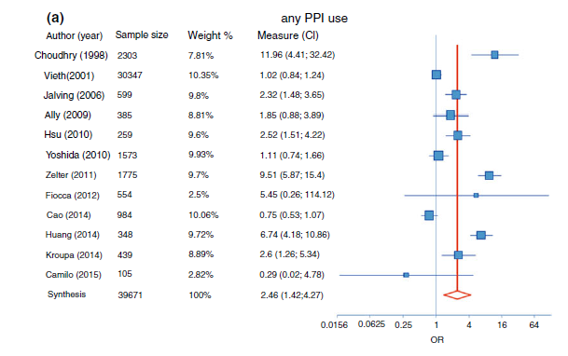
Fundik gland polibi oluşumunu artırıyor
OR 2.46
Martin FC, et al. Aliment Pharmacol Ther 2016; 44: 915–925

Slide 26
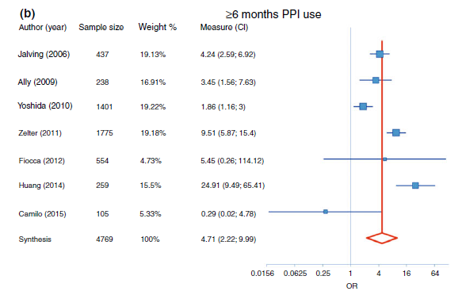
OR: 4.71
Martin FC, et al. Aliment Pharmacol Ther 2016; 44: 915–925

Slide 27
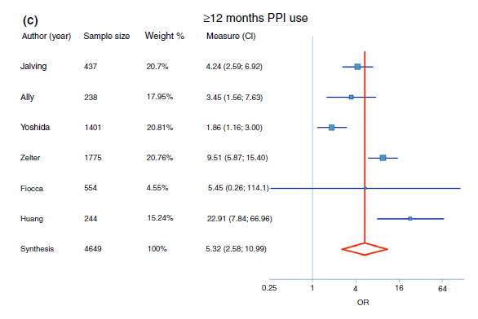
Uzun dönem kullanımda risk daha fazla artar
OR: 5.32
Martin FC, et al. Aliment Pharmacol Ther 2016; 44: 915–925

Slide 28
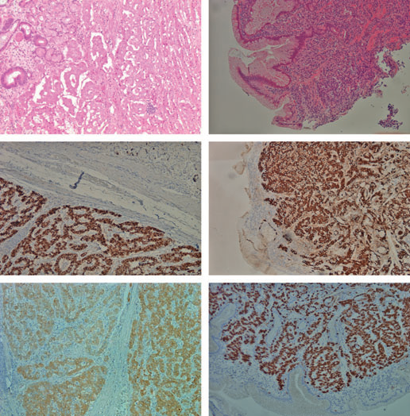
Gastrik karsinoid
Toplam 3 vaka
(12, 13 ve 15 yıl)
Jianu CS, et al. Aliment Pharmacol Ther 2012; 36: 644-649
Jianu CS, et al. Scand J Gastroenterol. 2012 Jan;47(1):64-7

Slide 29
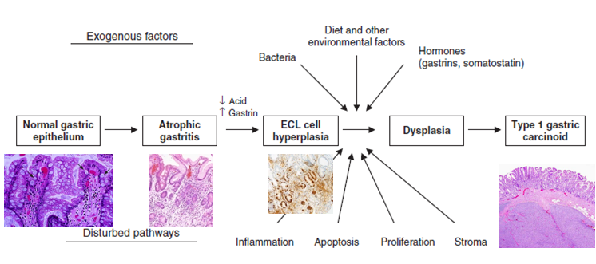
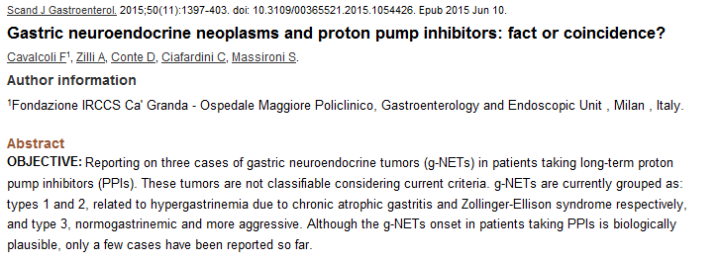

Slide 30
NET SIKLIĞI ARTMAKTA
6.00
600
Tüm malign neoplazmlar
5.00
500
4.00
400
İnsidans 100,000 - NET
İnsidans 100,000 – Tüm malign neoplazmlar
3.00
300
2.00
200
1.00
Nöroendokrin tümörler
100
0.00
0
1973
1974
1975
1976
1977
1978
1979
1980
1981
1982
1983
1984
1985
1986
1987
1988
1989
1990
1991
1992
1993
1994
1995
1996
1997
1998
1999
2000
2001
2002
2003
2004
Yao JC . J Clin Oncol. 2008;26:3063-3072.

Slide 31
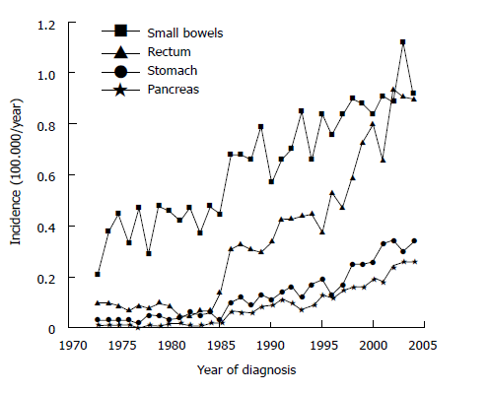
Mide de Net saptananda kes!
Scherülp H, et al. W J Gastrointest Endosc 2010

Slide 32
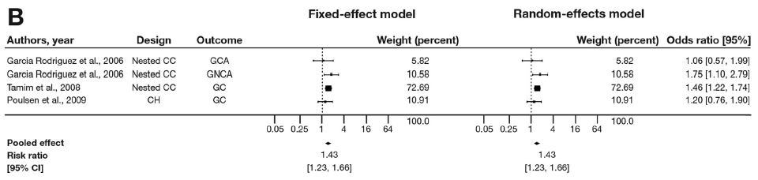
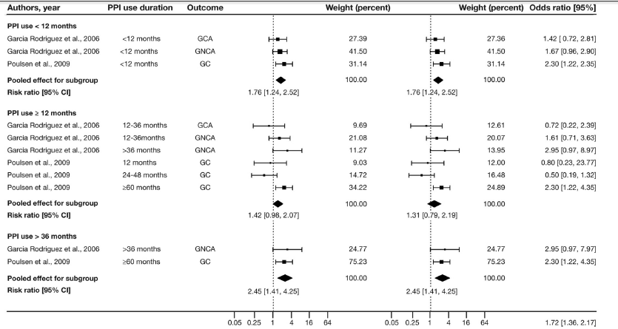
An Tran-Duy, et al. Clinical Gastroenterology and Hepatology 2016;14:1706–1719

Slide 33
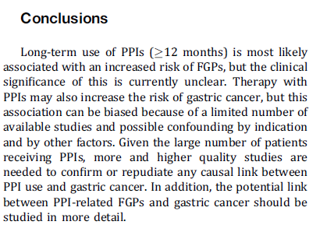
An Tran-Duy, et al. Clinical Gastroenterology and Hepatology 2016;14:1706–1719

Slide 34
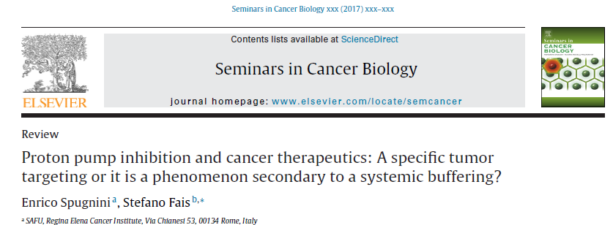
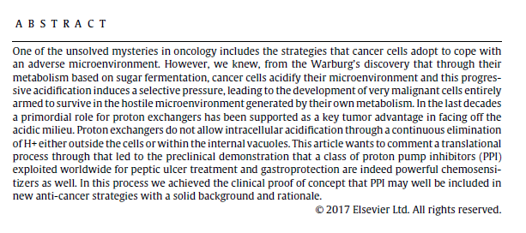

Slide 35
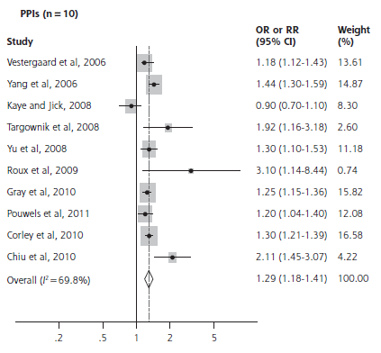
Uzun dönem kullanım (>1 yıl) fraktür riskini artırır
Eom CS, et al. Ann Fam Med 2011;9:257-267
Notes:
Ca d vit emilimi bozulur, Osteoklastların rezorbtif aktivitesini bozar,
Alternatively, PPI use may be linked to an increased risk of fracture through the action of osteoclasts on bone turnover. A vacuolar proton pump, similar to the parietal cell H+/K+ ATPase, is located on the ruffled border of osteoclasts. The acidic environment that is generated by the activity of these proton pumps aids in bone matrix dissolution and activation of proteases that participate in bone resorption. PPIs may inhibit these osteoclast proton pumps, resulting in diminished osteoclast function. Although it might be assumed that this would reduce fracture risk, the loss of osteoclast proton pump function may actually have a paradoxical effect. Congenital absence of osteoclast proton pumps leads to osteopetrosis that is characterized by increased cortical thickening, increased bone mineral density, and a tendency to recurrent fractures. Inhibition of osteoclast-mediated bone resorption may lead to heterogeneous increase in bone mineral density, impaired microfracture repair, and so to an increased risk of fracture . PPIs may decrease bone resorption by inhibiting osteoclastic vacuolar H+/K+ ATPase activity. Osteoclasts possess proton pumps, which are used during the excretion of H+ ions for bone resorption. Osteoclast-selective PPIs may therefore be used as antiresorptive agents with the potential of preventing fractures.Administration of a selective inhibitor of the osteoclastic vacuolar H+/K+ ATPase prevents bone loss in ovariectomized rats, an animal model representative of postmenopausal osteoporosis. As bone resorption is necessary for the development of normal bone microstructure, however, one may speculate that PPI-induced blockade of the osteoclast-associated vacuolar proton pump may actually increase fracture risk

Slide 36
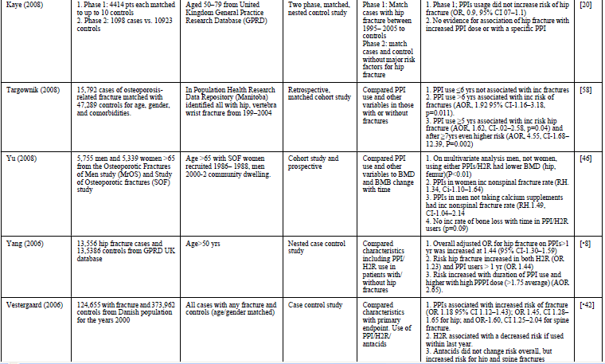
Doz ve süre ile paralel risk artıyor
Ito T, et al. Curr Gastroenterol Rep. 2010 December ; 12(6): 448–457

Slide 37
PPI – kemik kırığı olası mekanizma
Yang YX, Metz DC. Safety of Proton Pump Inhibitor Exposure. Gastroenterology 2010;139:1115–1127

Slide 38
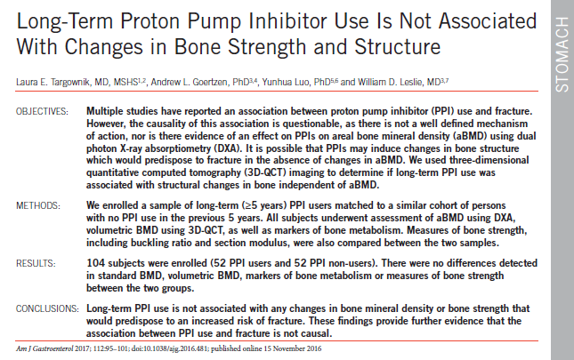

Slide 39
Mikroskopik kolit – PPI
(kollajenöz kolit / lenfositik kolit)
Özellikle lansoprazol düşünülmeli
Japonya’da kollajenöz kolit % 51.1-69.8 lansoprazol ile ilgili, kesilmesi ile % 90.4 rezolusyon
Clinics in Digestive Tract 2012;17:101-6

Slide 40
Böbrek ve ppı

Slide 41
Akut interstisyel nefrit idiyosinkratik olarak kısa dönemde nadiren gelişebilir.
Am J Kidney Dis 2014;64:558

Slide 42
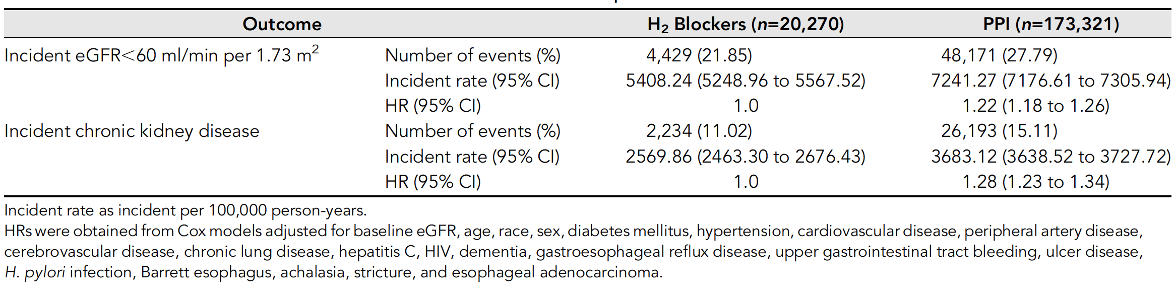
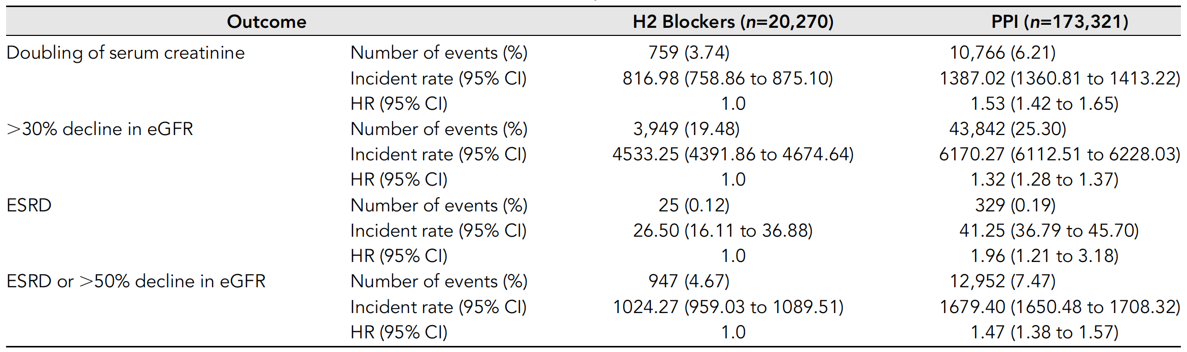
Kby ve ppı
Yan Xie , et al. Proton Pump Inhibitors and Risk of Incident CKD and Progression to ESRDJ Am Soc Nephrol 27: 3153–3163, 2016.

Slide 43
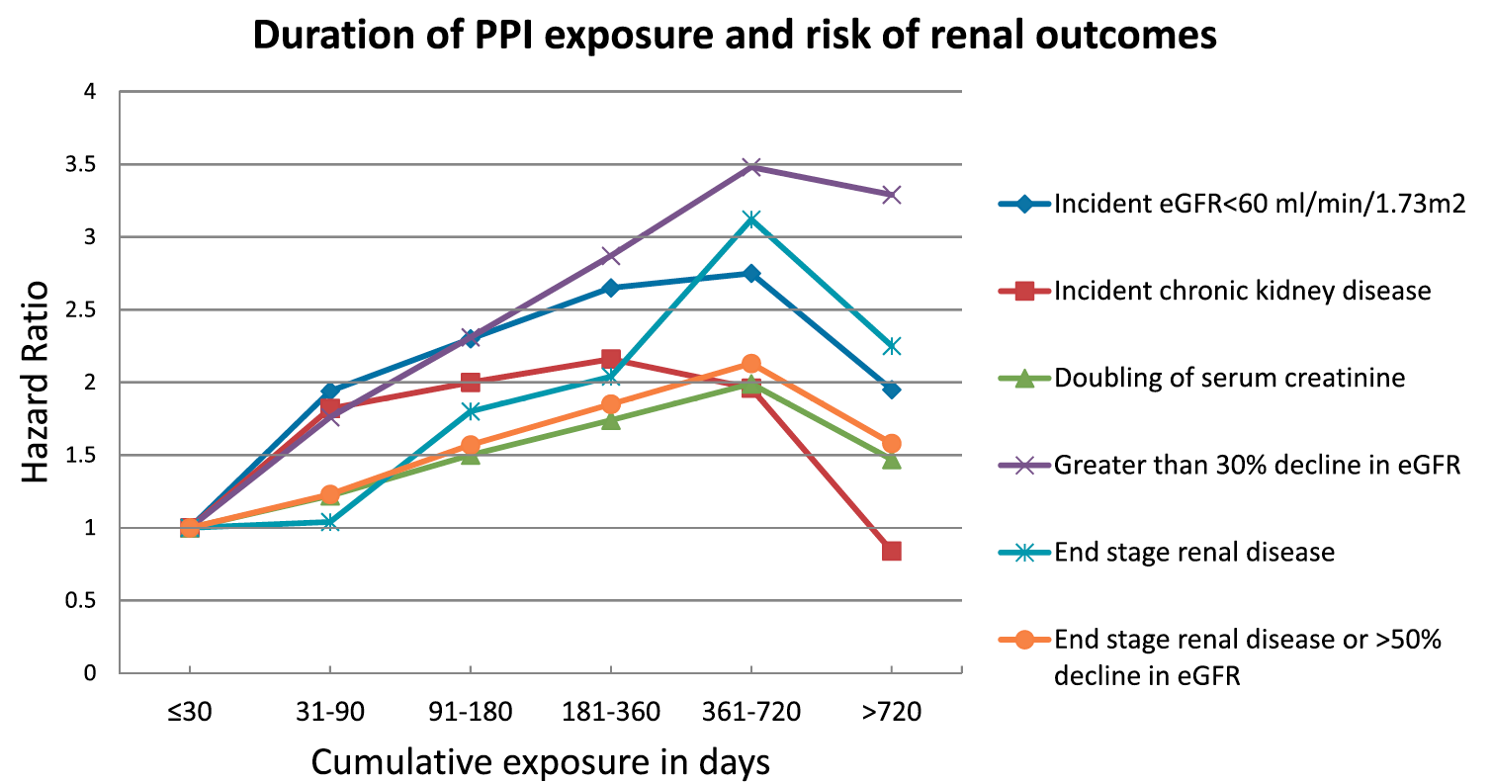

Slide 44
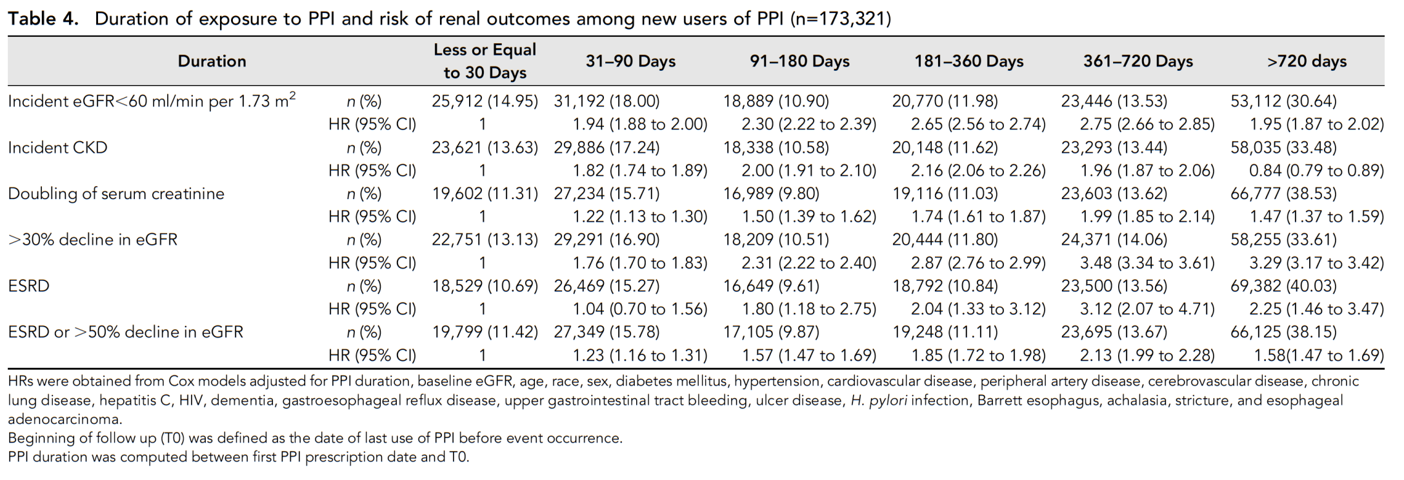


Slide 45
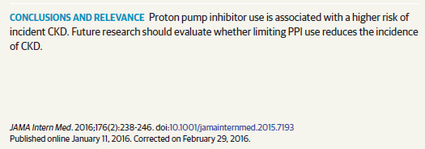
Yaşlı hastalarda
Komorbidite (DM, vs)
İlaçlar
ACE inhibitörü kullanımı
Diüretik kullanımı
sorgulanmalı

Slide 46
İlaç etkileşimi

Slide 47
Ho PM et al JAMA. 2009;301(9):937-944
Klopidogrel ile birlikte PPI kullananlarda akut koroner sendrom riski artıyor!
Clopidogrel + PPİ
Clopidogrel - PPİ

Slide 48
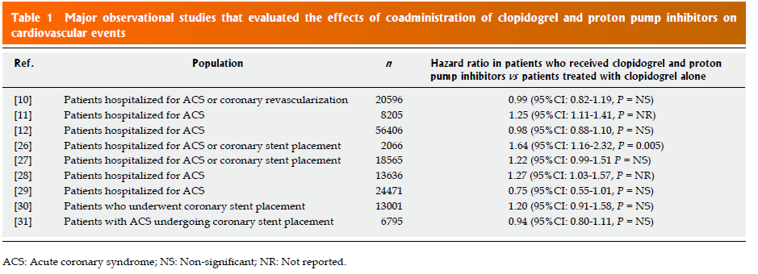
Stella D Bouziana, Konstantinos Tziomalos
World J Gastrointest Pharmacol Ther 2015

Slide 49
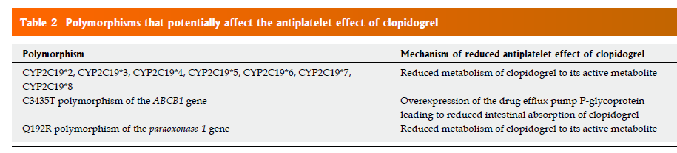
clopidogrel
İlaç etkileşimi
Stella D Bouziana, Konstantinos Tziomalos .
World J Gastrointest Pharmacol Ther 2015

Slide 50
Clopidogrel irreversibly binds the P2Y12 receptor
for adenosine diphosphate on platelet cell membranes to inhibit platelet aggregation.
Patients who carry CYP2C19 loss-of-function alleles haven increased ex vivo platelet aggregation while taking clopidogrel.
Because PPIs are also metabolized by CYP2C19,
competitive inhibition of CYP2C19 by PPIs could cause loss of clopidogrel’s antiplatelet effects.

Slide 51
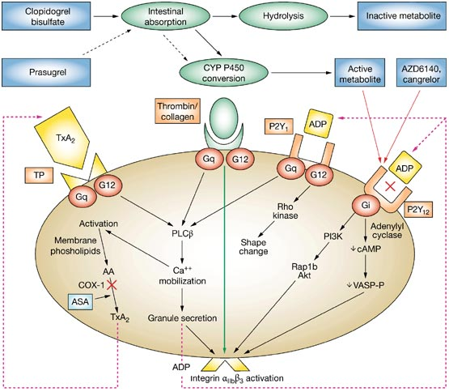

Slide 52
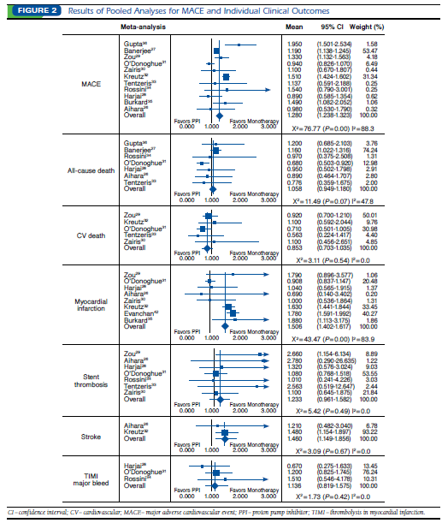
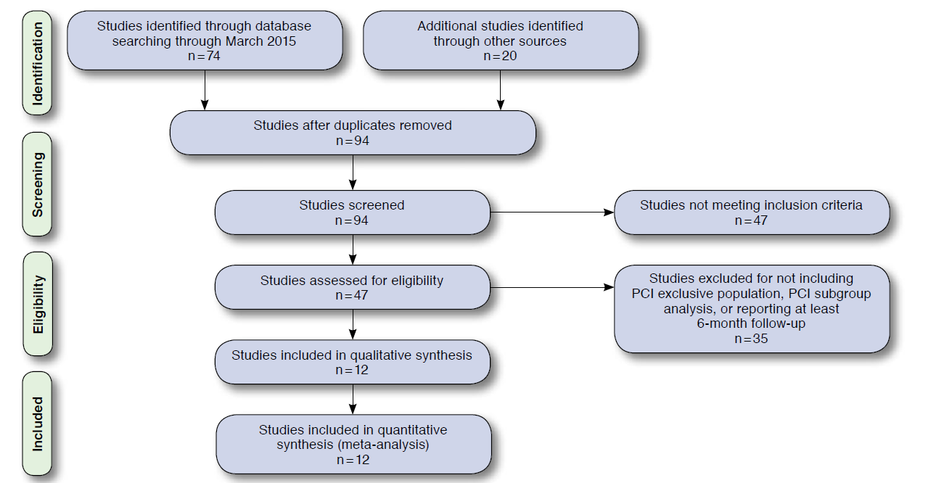
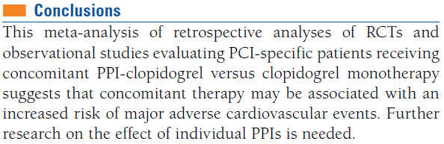
Michael A. Serbin, et al. Manag Care Spec Pharm. 2016;22(8):939-47

Slide 53
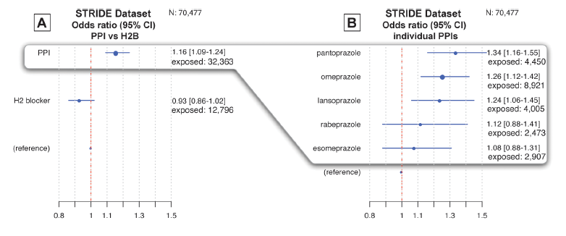
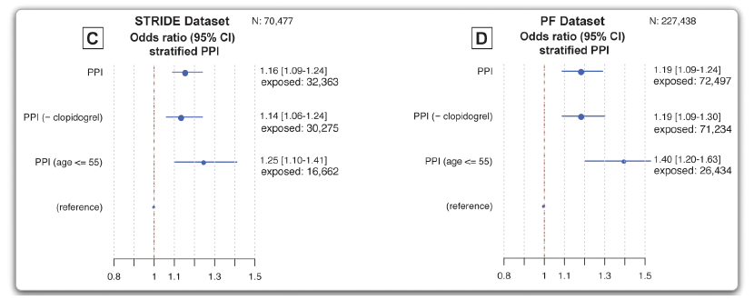
MI riski yaş ve Klopidogrelden bağımsız artıyor
Nigam H. Shah, et al. PlosOne 2015
Notes:
PPI use is associated with an increased risk for MI, regardless of age or clopidogrel use. No association is identified for H2 Blocker use: In the fig, the dotted red line represents the reference point indicating no elevated risk for myocardial infarction (MI). The odds ratio and 95% confidence interval for each exposure are indicated by a blue dot and blue line, respectively, which are also represented numerically to the right of each fig. The size of the dot is
proportional to the exposure size of each group (see Table 1). Fig A, derived from STRIDE (N = 70,477), shows that PPIs have a class-level effect for MI in the general population of patients with GERD. By comparison, H2 blockers, an alternate treatment, have no association. Fig B breaks down the associations for each PPI individually. Figs C and D use stratification to show that the signals are corroborated in two independent datasets (STRIDE and Practice Fusion)and are robust in important subgroups. Fig C shows that, for the STRIDE dataset, when patients on clopidogrel are excluded, the associations are unchanged. Also, in lower-risk age groups for MI, the associations are still present. Similar trends are seen in these subgroups in the Practice Fusion (PF) dataset (N = 227,438) shown in Fig D. Nigam H. Shah1

Slide 54

Ppı klopidogrel kullanımı ve yaştan bağımsız MI riskini artırıyor
Nigam H. Shah, et al. PlosOne 2015

Slide 55

Dimethylarginine Dimethylaminohydrolase inhibisyonu
DANIEL E. FREEDBERG. Et al. Gastroenterology 2015;149:830–833
Notes:
Putative mechanism linking proton pump inhibitors with enhanced vascular contractivity and reduced vascular relaxation. ADMA, asymmetrical dimethylarginine; DDAH, dimethylarginine dimethylaminohydrolase; DMA,
dimethylarginine; NO, nitric oxide.
PPIs inhibit dimethylarginine dimethylaminohydrolase (DDAH), leading to increased levels of asymmetrical dimethylarginine (ADMA), blockade of vascular nitric oxide synthase activity, and enhanced contractivity with loss of normal relaxation

Slide 56



Gargiulo G, et al. Am Heart J 2016;174:95-102
Notes:
percutaneous coronary intervention (PCI) and dual-antiplatelet therapy (DAPT)

Slide 57

NASIL KULLANILDIĞI ÖNEMLİ

Slide 58

Sabah PPI, yatarken klopidogrel veya öğlen klopidogrel, akşam yemekten önce PPI

Slide 59

Chen CB, et al. Clinical Therapeutics/Volume 38, Number 6, 2016

Slide 60



Slide 61

Ppı demans için risk faktörü b 12 eksikliği, beta-amiloid artışı
Gomm W, et al. JAMA Neurol. 2016;73(4):410-416.
Notes:
Vitamin B12 deficiency
has been shown to be associated with cognitive decline.11 In
another study,12 PPIswere observedto enhanceβ-amyloid (Aβ)
levels in the brains of mice by affecting the enzymes β- and
γ-secretase. Modulation of the degradation of Aβ by lysosomes
in microglia could be another functional aspect of the
enrichment of Aβ levels by PPIs.13-16

Slide 62




Slide 63


Slide 64
POTANSİYEL RİSKLER
Enterik infeksiyonlar ( C.dificile 2 kat artar)
Toplumdan kazanılmış pnömoni
Kırık riski
İlaç etkileşimleri gözönünde bulundurulmalı
Nutrisyonel eksiklikler (B12 , demir, Mg)
Nöroendokrin hücre hiperplazisi
Sirotik hastalarda HE ve SBP riskini artırırlar
Özellikle yaşlılarda demans ve KBY ye dikkat…
İskemi riskini klopidogrelden bağımsız artırabilir……
Notes:
With the long-term use of any medication, drug safety becomes an important issue. The three main concerns regarding the long-term safety of proton pump inhibitors (PPIs) include the effects of prolonged hypochlorhydria and hypergastrinemia, and the possible association of PPIs with gastric atrophy.
C. difficile is an anaerobic organism that sporulates; acid-resistant spores are presumed to be the major vector of disease transmission. The role of potent acid suppression and the pathophysiologic mechanisms involved in increasing the risk of C. difficile by PPI use are unclear.

Slide 65
SORGULA
Endikasyon doğru mu?
Kemik taraması yap
Fundik gland polipleri, atrofik gastrit ve mide NET varsa kes
Mg ve B12 kontrolü yap
Yaşlıda GFR kontrolü yap
Klopidogrel ile arada 12 saat olsun
Azaltarak kes (rebound hipersekresyon için)
İskemik kalp hastalığı varsa gerekmedikçe verme…
Yaşlı hastada polifarmasiden kaçın…….

Slide 66
                HEDEF
En az süre, en az doz……………..!

Slide 67




